Slide 1

Weather Application
ST10460454

Slide 2
Purpose of the app
The purpose of this app is to provide users with the average temperature for the week and it will also allow users to view a detailed information of each days' temperature. This application will manage the weekly weather condition.

Slide 3
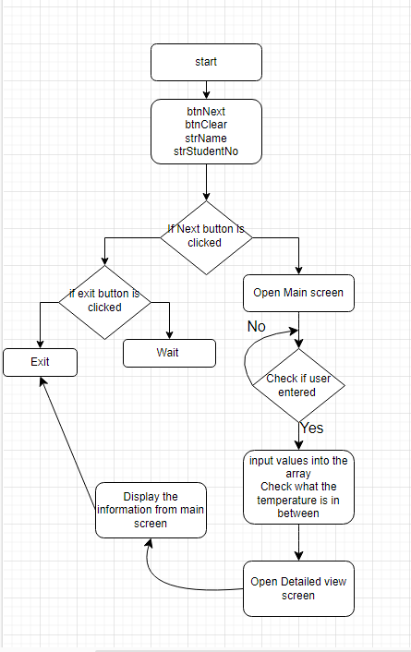
FLOWCHART

Slide 4
GITHUB LINK
https://github.com/MkansiMusa/PRACTICUM-EXAM

Slide 5
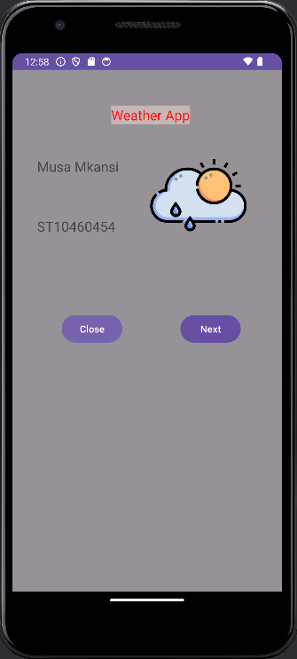
Splash screen
On the splash screen you will find the following name of the app, logo, and a exit and next button

Slide 6
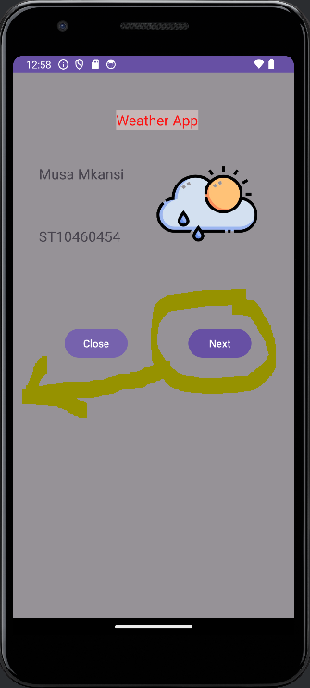
Next Button
The next button is a button that a user will you to go the next screen

Slide 7
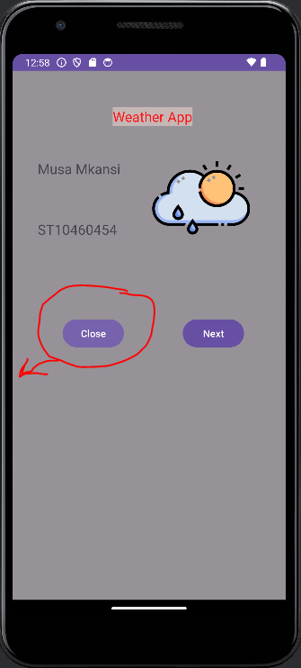
Close button
The close button is a button that will be used to close the application

Slide 8
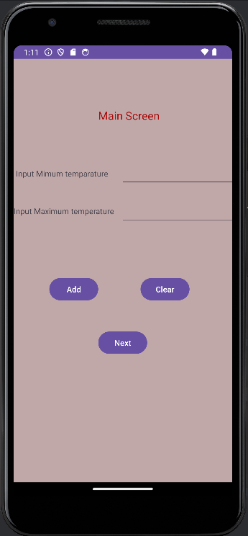
Main Screen
The main screen is the screen where the user will be asked to enter the minimum and maximum temperature, it has 3 different buttons namely, add button, Clear button and the next button

Slide 9
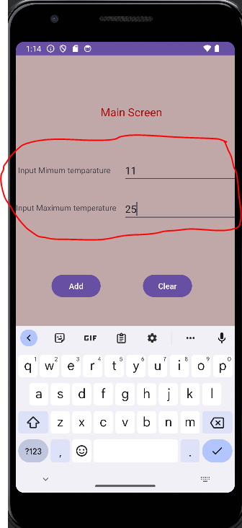
Input values
On the EditTexts that where the user will enter the minimum and maximum temperature

Slide 10
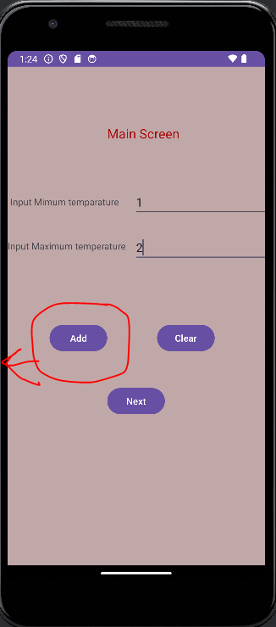
Add button
Add button is a button that will used to save the values the user entered

Slide 11
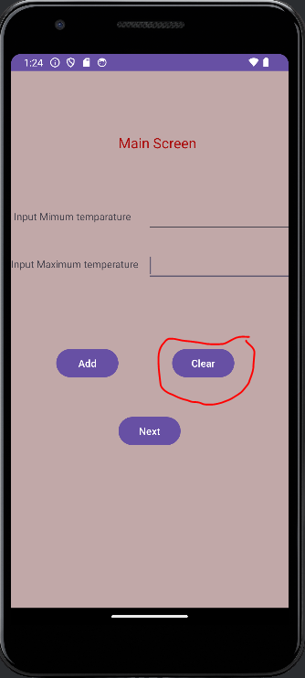
Clear button
The clear button is a button that will be used to clear all the inputs the user has entered allowing them to enter new input

Slide 12
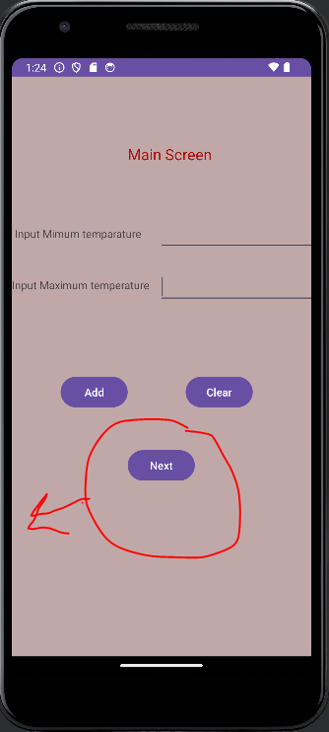
Next button
It is a button that will be used to navigate to the next page and will also have the ability to display information in the next page

Slide 13
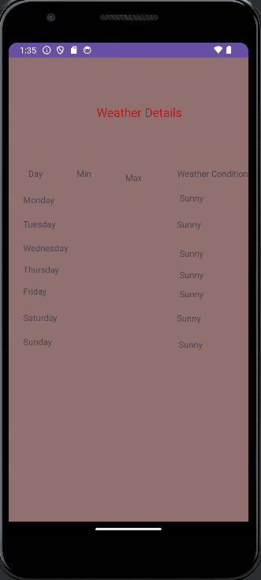
Detailed View Screen
The detailed view screen is the screen that will show the user how temperature will be like on specific days and even display the minimum and maximum temperature

